Slide 1
The need for Big Data
Let’s look at some examples.
Facebook currently stores 300 petabytes of data
Facebook processes approximately 600 terabytes of data per day
Facebook handles one billion users per day
Facebook processes 2.7 billion ‘Likes’ per day.
300 million photographs uploaded every day.
Notes:
1

Slide 2
The need for Big Data
The United States National Security Agency (NSA)
The NSA currently stores approximately five exabytes of data
The NSA processes approximately 30 petabytes of data per day
The NSA touches approximately 1.6 percent of all internet traffic per day (More than Google).
Data such as web searches, phone calls, credit card transactions, health information is stored and analyzed.
Notes:
1

Slide 3
The need for Big Data
Google.
Google processes 100 petabytes of information per day
Google indexes 60 trillion web pages per day
Google has greater than one billion unique searches per month
Google processes 2.3 million searches per second.
Notes:
1

Slide 4
The need for Big Data
No single hardware platform can handle data sets this large.
Notes:
1

Slide 5
Big Data Requirements
To process this volume of data you need three things.
The ability to store massive quantities of data
The ability to extract and process elements of this data in a timely fashion.
The ability for the system to scale as the volumes of data increase.
Notes:
1

Slide 6
Examples of scalability requirements
LinkedIn grew from 37 million users in Q1 2009 to 450 million users in Q2 2016.
No single hardware platform can match these scalability requirements, no matter how much memory, CPU and storage is allocated to it.
Notes:
1

Slide 7
History of Big Data systems.
Google developed this concept in the early 2000’s after realizing that the web was growing too quickly for existing architectures to process it.
Google created two systems to address this problem.
The Google File System to solve the problem of distributed storage
The MapReduce programming architecture. to solve the problem of distributed processing.
Notes:
1

Slide 8
History of Big Data systems.
The Apache foundation took Google’s technologies and developed an open source version.
The Google File System became HDFS
The MapReduce architecture became Hadoop’s Mapreduce
Hadoop is the name for the overall system architecture.
It includes HDFS, MapReduce and YARN.
b
Notes:
1

Slide 9
History of Big Data systems.
Hadoop 2.0 released by the Apache Foundation in 2013.
Hadoop 2.0 is a fundamental change in the architecture.
The resource manager YARN was split from the MapReduce system and created as its own subsystem.
b
Notes:
1

Slide 10
History of Big Data systems.
Hadoop 2.0 released by the Apache Foundation in 2013.
Hadoop 2.0 is a fundamental change in the architecture.
The resource manager YARN was split from the MapReduce system and created as its own subsystem.
Notes:
1

Slide 11
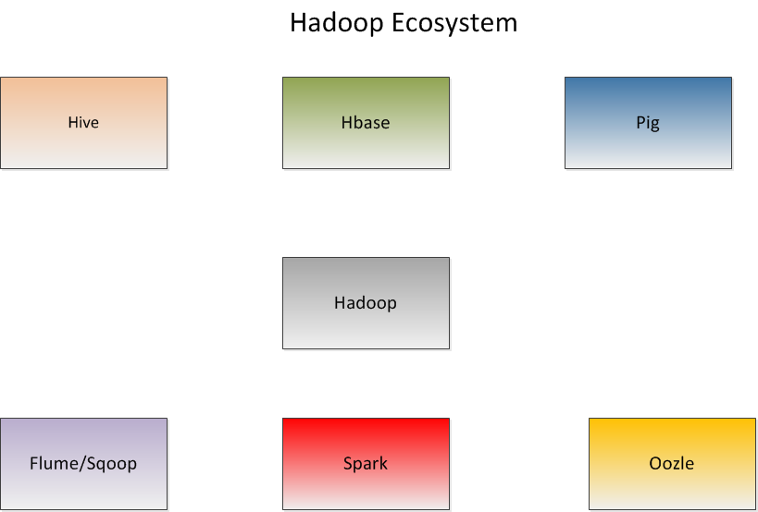
Notes:
1

Slide 12
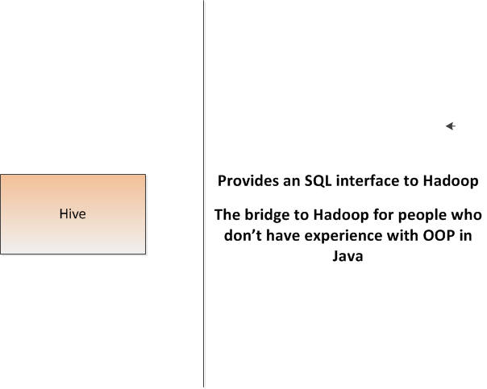
`
Notes:
1

Slide 13
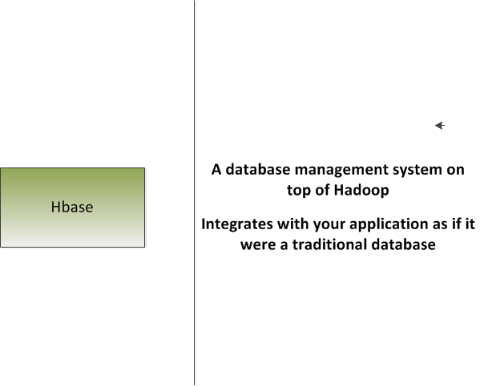
`
Notes:
1

Slide 14
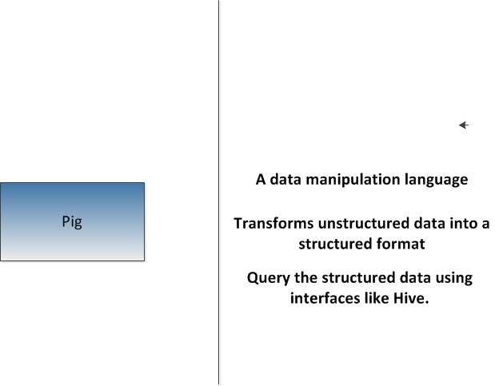
`
Notes:
1

Slide 15
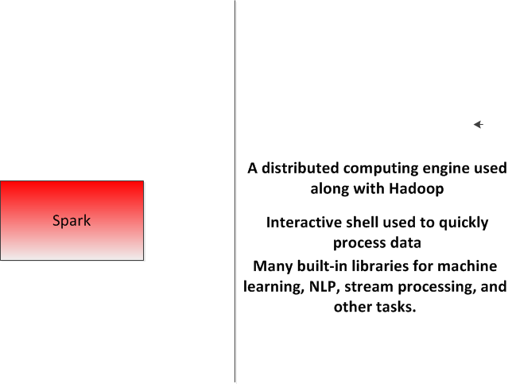
`
Notes:
1

Slide 16
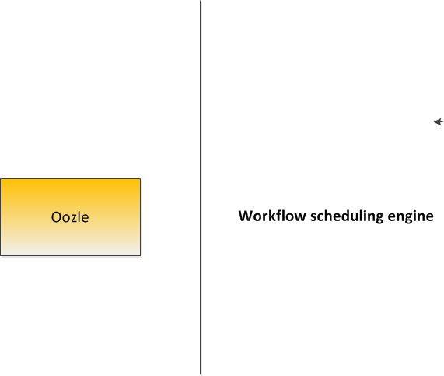
`
Notes:
1

Slide 17
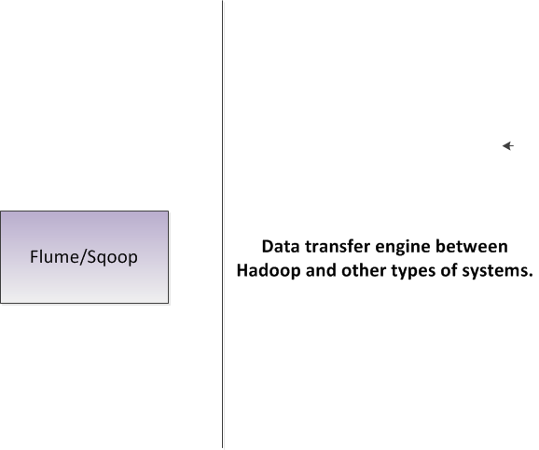
Notes:
1

Slide 18
HDFS Design
Each HDFS data node is a simple off-the-shelf system.
HDFS is highly fault tolerant . Hardware failures are assumed.
HDFS is designed for batch processing, HDFS is used for high throughput requirements rather than low latency requirements.
Queries to HDFS are not usually done in real time.
HDFS supports very large data set sizes.
b
Notes:
1

Slide 19
HDFS Design
Default block size for Hadoop is 64 Mb.
Default blocksize for the Cloudera distribution is 128 Mb
Files are split among multiple machines and disk storage in a cluster.
One of the machines in a cluster is the master (name) node,
The rest of them are data nodes.
b
Notes:
1

Slide 20
HDFS Design
The name node stores the meta data for all files stored in the HDFS.
There is one name node per cluster and possibly a secondary name node.
The name node stores all of the metadata for files.
Consider a file lik e a book. The name node stores the index
The data nodes store the actual pages.
b
Notes:
1

Slide 21
HDFS Design
The name node stores the meta data for all files stored in the HDFS.
There is one name node per cluster and possibly a secondary name node.
The name node stores all of the metadata for files.
Consider a file lik e a book. The name node stores the index
The data nodes store the actual pages.
b
Notes:
1

Slide 22
HDFS Design
The name node has two primary responsibilities.
First, it manages the HD file system. All requests from a client for data go to the name node first.
The name node stores the file system directory structure and all other metadata about each file.
The data node actually stores the data in blocks on its disk storage devices.
b
Notes:
1

Slide 23
HDFS Design
A typical data file is a large text file (size in terabytes or petabytes).
This file is broken up into chunks called blocks.
Each block is stored on a different node in the hadoop cluster.
Each block is the same size.
Differently sized files are treated the same way.
Storage is simplified. We only deal with blocks.
A single unit for fault tolerance and replication.
b
Notes:
1

Slide 24
HDFS Design
The default block size in Hadoop is 64 MB (128 MB for Cloudera installations).
Block size is a trade off between parallelism and overhead.
Large block sizes means less processes working. Each process only works on one block
Smaller block sizes means more network and processing overhead.
Optimal blocksize depends on type of data and other considerations.
Notes:
1

Slide 25
HDFS Design
The default block size in Hadoop is 64 MB (128 MB for Cloudera installations).
Block size is a trade off between parallelism and overhead.
Large block sizes means less processes working. Each process only works on one block
Smaller block sizes means more network and processing overhead.
Optimal blocksize depends on type of data and other considerations.
Hadoop does its best to run all its tasks on the system that stores the block. This is data locality optimization.
Notes:
1

Slide 26
HDFS Design
The default block size in Hadoop is 64 MB (128 MB for Cloudera installations).
Block size is a trade off between parallelism and overhead.
Large block sizes means less processes working. Each process only works on one block
Smaller block sizes means more network and processing overhead.
Optimal blocksize depends on type of data and other considerations.
Hadoop does its best to run all its tasks on the system that stores the block. This is data locality optimization
Notes:
1

Slide 27
HDFS Design
Hadoop nodes are generally implemented as commodity hardware.
Commodity hardware can fail.
We have to consider possibility of failure in the name node and data nodes.
Some data in a block may get corrupted.
A data node could crash completely, causing us to lose access to all the data stored.
Notes:
1

Slide 28
HDFS Design
Hadoop replicates every file and block stored in the HDFS.
We define a replication factor to decide how data is replicated.
Replication locations are also stored in the name node.
Replication strategy needs to optimize two variables
First, the redundancy factor. A higher redundancy factor means more security.
Second, the write bandwidth. A higher redundancy factor also means a higher write time.
Notes:
1

Slide 29
HDFS Design
Nodes on different racks are further away than nodes on the same rack.
A cluster of machines is made up of systems stored on different racks in a system room.
Read/write bandwidth for inter rack nodes are lower than for intra rack nodes.
Replication strategy is defined in hdfs-site.xml configuration file.
Notes:
1

Slide 30
HDFS Design
Hadoop then chooses another rack in a different location and writes the second replica to it.
The third replica is on the new rack (but on a different node) as well,
Replication strategy is defined in hdfs-site.xml configuration file.
Notes:
1

Slide 31
HDFS Design
A cluster of machines is made up of systems stored on different racks in a system room.
Nodes on different racks are further away than nodes on the same rack.
Read/write bandwidth for inter rack nodes are lower than for intra rack nodes.
The default replication strategy is to replicate data on one node as close to the same rack as possible.
Notes:
1

Slide 32
HDFS Design
Hadoop then chooses another rack in a different location and writes the second replica to it.
The third replica is on the new rack (but on a different node) as well,
Replication strategy is defined in hdfs-site.xml configuration file.
Notes:
1

Slide 33
HDFS Design
Fault tolerance planning must also take into consideration failure of the name node.
Name node failure means that all of the data in the cluster is permanently lost.
With name node failure, all file/block mapping is gone.
Two specific strategies for overcoming name node failure.
First is the metadata files.
Second is the secondary name node.
Notes:
1

Slide 34
HDFS Design
Two metadata files associated with the name node.
First is the fsimage File system image.
Second is the edit log.
Notes:
1

Slide 35
HDFS Design
The fsimage file holds a snapshot of the hadoop cluster's file system on startup.
It contains the image of the file system before any writes have been performed.
FSImage is loaded into memory on startup.
Notes:
1

Slide 36
HDFS Design
The edit log contains a log of all modifications to files in the cluster's file system since startup.
Putting together the fsimage and the edit log can reconstruct the data in the hdfs cluster.
Both files are by default saved to a local file system directory on the name node.
Alternatively (or simultaneously) this data can be saved to a remote location over the network.
Merging these two files can be computationally intensive.
Notes:
1

Slide 37
HDFS Design
The secondary name node contains a replica of the fsimage and edit log from the master.
The secondary namenode merges the files together according to a specifically defined checkpoint.
The newly merged fsimage is then copied back to the primary name node.
The edits log on both nodes is than reset.
Notes:
1

Slide 38
HDFS Design
Two ways to define checkpointing.
First is to checkpoint after a specific amount of time.
Second is to checkpoint after a specific number of transactions are completed.
The newly merged fsimage is then copied back to the primary name node.
The edits log on both nodes is than reset.
Notes:
1

Slide 39
HDFS Read and Write Operations
To write a file in HDFS, a client needs to interact with the namenode master.
The HDFS clietn sends a create() request on the DistributedFileSystem API.
The API makes a Remote Procedure Call (RPC) to the namenode to create a new file in the namespace.
The namenode performs various checks to make sure that the file doesn’t already exist and that the client has valid create permissions.
The namenode makes a record of the file if all checks pass.
Otherwise, the namenode throws an IOException.
Notes:
1

Slide 40
HDFS Read and Write Operations
The API returns an DFSDataOutputStream object for the client to start writing data to.
DFSOutputStream splits the client data into packets and writes it to an internal queue called the data queue.
The data queue is consumed by the DataStreamer object which is responsible for asking the namenode to allocate new blocks.
The list of datanodes form a pipeline.
The DataStreamer streams the packets to the first datanode in the pipeline.
Notes:
1

Slide 41
HDFS Read and Write Operations
The first datanode stores the packet and then forwards it to the next datanode in the pipeline.
Similarly, the second datanode stores the packet and forwards it to the third datanode in the pipeline.
And so on until all datanodes in the pipeline have received and stored the packet.
Once the client has finished writing data, the close()method is called on the stream object.
The close flushes all remaining packets to the pipeline and waits for an acknowledgement.
After acknowledgement, the client signals to the namenode that the file is complete.
Notes:
1

Slide 42
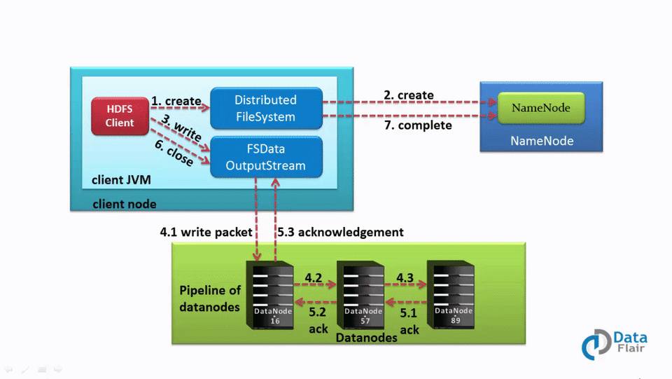
HDFS Read and Write Operations
Notes:
1

Slide 43
HDFS Read and Write Operations
To read a file from HDFS, a client needs to interact with the master namenode.
The namenode verifies the clients access privileges.
If checks pass, then the master returns the address of the slaves where the file is stored.
The client then interacts directly with the respective datanodes to read the data.
Notes:
1

Slide 44
HDFS Read and Write Operations
The client starts by opening the file using the open() methodon the FileSystem object, which is an instance of the DistributedFileSystem class.
The DistributedFileSystem makes an RPC call to determine the location of the blocks for the first few blocks in the file.
For each block, the namenode returns the addresses of the relevant datanodes. The addresses are sorted by proxmity to the client.
Notes:
1

Slide 45
HDFS Read and Write Operations
The DistributedFileSystem returns an FSDataInputStream object to the client.
FSDataInputStream wraps the DFSInputStream object.
DFSInputStream manages the namenode and datanode I/O.
The client calls the read() method on the stream.
DFSInputStream connects the client to the closest dastanode for the first block in the file.
Data is streamed from the datanode back to the client. As a result, the client call call read() repeatedly on the stream.
Notes:
1

Slide 46
HDFS Read and Write Operations
If the DFSInputStream encounters an error when communicating with the datanode, it will then try the next closest datanode. It also remembers failed datanodes so that it won’t attempt to retry them for later blocks.
DFSInputStream verifies checksums for the data transferred to it.
Corrupt blocks are reported to the namenode before it attempts to read the block from a different namenode.
Notes:
1

Slide 47
HDFS Read and Write Operations
When the client has finished reading the data, it calls a close() method on the stream object.
Notes:
1

Slide 48
HDFS Federation
Current HDFS architecture only allows for a single namespace for the entire cluster.
Namespace is managed by a single namenode.
These limitations are addressed by HDFS Federation
Notes:
1

Slide 49
HDFS Federation
Namespaces can only be scaled vertically on a single namenode.
This limits the number of blocks, files and directories to the memory resources of the namenode.
Throughput of the cluster are also limited to the namenodes.
Notes:
1

Slide 50
HDFS Federation
HDFS Federation uses multiple independent namenodes/namespaces.
The namenodes are federated, in that they are independent of each other.
The datanodes are common storage for all the namenodes.
Each datanode registers with each namenode in the cluster.
Datanodes send periodic heartbeats and block reports and handles commands from the namenodes.
Notes:
1

Slide 51
HDFS Federation
A Block Pool is a set of blocks that belong to a single namespace. Datanodes store blocks for all the block pools in the cluster.
It is managed independently of other block pools.
This allows a namespace to generate Block IDs for new blocks without the need for coordination with the other namespaces.
The failure of a namenode does not prevent the datanode from serving other namenodes in the cluster.
Notes:
1

Slide 52
HDFS Federation
A Namespace and its block pool together are called Namespace Volume.
It is a self-contained unit of management. When a namenode/namespace is deleted, the corresponding block pool at the datanodes is deleted.
Each namespace volume is upgraded as a unit, during cluster upgrade.
Notes:
1

Slide 53
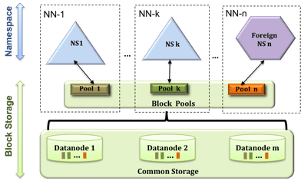
HDFS Federation
Notes:
1

Slide 54
HDFS Federation
Key Benefits
Scalability and isolation
Support for multiple namenodes horizontally scales the file system namespace.
It separates namespace volumes for users and categories of applications and improves isolation.
Notes:
1

Slide 55
HDFS Federation
Key Benefits
Generic storage service
Block pool abstraction opens up the architecture for future innovation.
New file systems can be built on top of block storage.
New applications can be directly built on the block storage layer without the need to use a file system interface.
New block pool categories are also possible, different from the default block pool.
Notes:
1

Slide 56
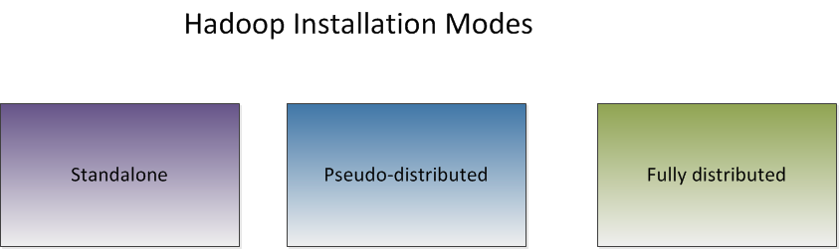
HDFS Installation
Notes:
1

Slide 57
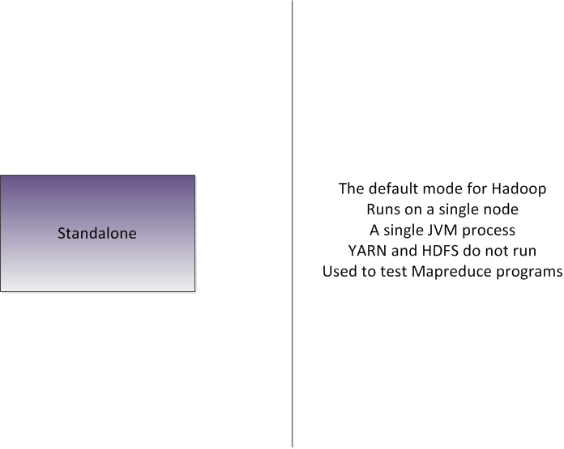
Notes:
1

Slide 58
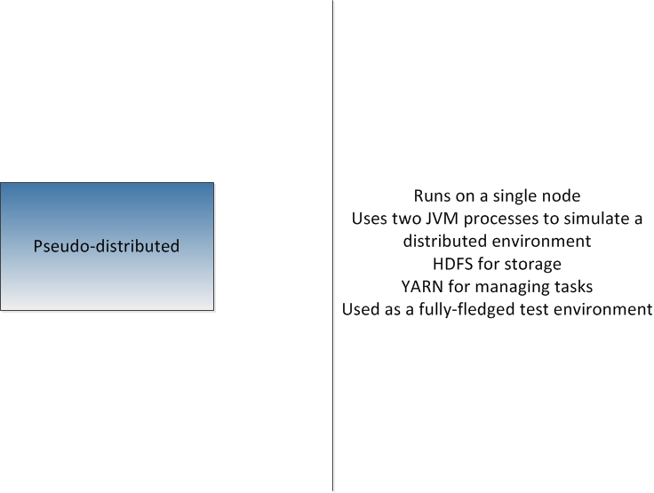
Notes:
1

Slide 59
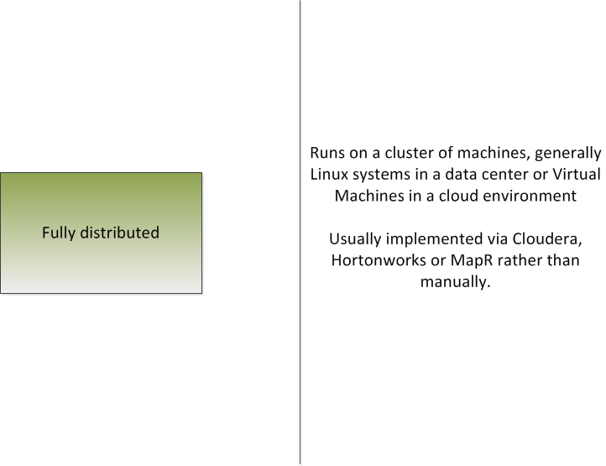
Notes:
1

Slide 60
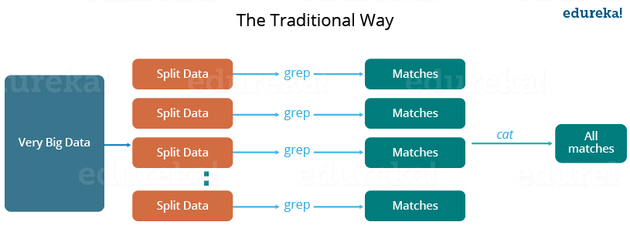
Notes:
1

Slide 61
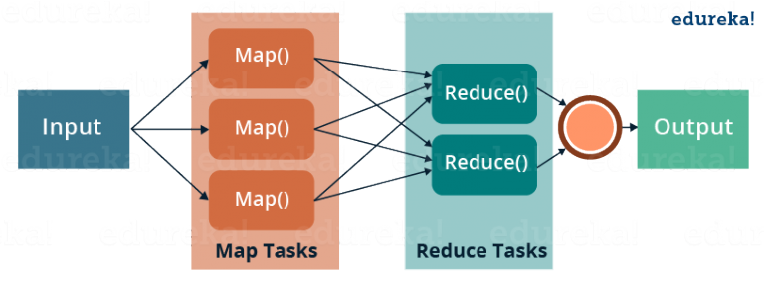
Notes:
1

Slide 62
MapReduce
Mapreduce jobs require running processes on many different machines.
Mapreduce is a programming paradigm that allows processing on distributed systems.
Modern systems generate millions of records of raw data.
This data can be many petabytes in size.
These sort of tasks are run in two phases, the map phase and the reduce phase.
Notes:
1

Slide 63
MapReduce
The map task divides a job into many different processes, each running on a different compute node.
The reduce task takes the output of the many map tasks and runs some sort of reducing function on it to generate the desired output.
The developer only needs to write a map and reduce function. All of the fault tolerance is handled by hadoop itself.
Map output is in the form of key/value pairs.
The reduce function takes these key/value pairs and runs a reducing function to get the desired output to the client,.
Notes:
1

Slide 64
MapReduce
In order to run a mapreduce job on the Hadoop cluster, the job must be compiled into a JAR file.
This jar file is then copied to the designated Hadoop distribution directory for processing.
A Mapreduce input directory needs to be created in the cluster's HDFS.
To actually run a hadoop job, use the hadoop jar command.
Notes:
1

Slide 65
Mapreduce
When a job has been submitted, you will see a job id starting with 'job_id<xxxxx>'
Using this job ID, you can monitor the results of the hadoop job .
Hadoop provides a web based resource manager interface .
The default URL is http://localhost:8088.
Notes:
1

Slide 66
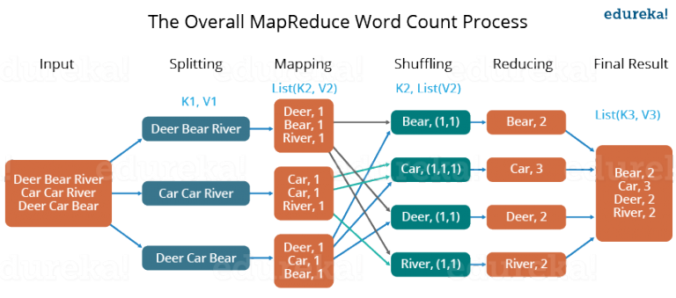
Mapreduce
Notes:
1

Slide 67
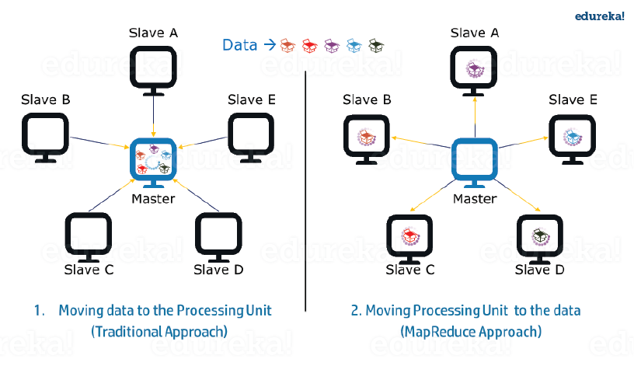
Mapreduce
Notes:
1

Slide 68
Mapreduce
Advantages
Parallel Processing.
Data Locality
Notes:
1

Slide 69
Mapreduce Optional Functions
Partitioners
Combiners
Notes:
1

Slide 70
Mapreduce Optional Functions
A partitioner works like a condition in processing an input dataset. The partition phase takes place after the Map phase and before the Reduce phase.
The number of partitioners is equal to the number of reducers. That means a partitioner will divide the data according to the number of reducers. Therefore, the data passed from a single partitioner is processed by a single Reducer.
Notes:
1

Slide 71
Mapreduce Optional Functions
A partitioner partitions the key-value pairs of intermediate Map-outputs.
It partitions the data using a user-defined condition, which works like a hash function.
The total number of partitions is same as the number of Reducer tasks for the job.
For example, if the input data is a list of employees by age and salary and gender, then we can use the partitioner to get maps by gender, i.e. one partition for males and one for females. Each partition is assigned to a reduce job.
Notes:
1

Slide 72
Mapreduce Optional Functions
A Combiner, also known as a semi-reducer, is an optional class that operates by accepting the inputs from the Map class and thereafter passing the output key-value pairs to the Reducer class.
The main function of a Combiner is to summarize the map output records with the same key. The output (key-value collection) of the combiner will be sent over the network to the actual Reducer task as input.
Notes:
1

Slide 73
Mapreduce Optional Functions
A combiner does not have a predefined interface and it must implement the Reducer interface’s reduce() method.
A combiner operates on each map output key. It must have the same output key-value types as the Reducer class.
A combiner can produce summary information from a large dataset because it replaces the original Map output.
Notes:
1

Slide 74
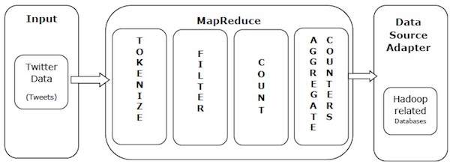
Mapreduce
Example
Notes:
1

Slide 75
Mapreduce
Example
Tokenize − Tokenizes the tweets into maps of tokens and writes them as key-value pairs.
Filter − Filters unwanted words from the maps of tokens and writes the filtered maps as key-value pairs.
Count − Generates a token counter per word.
Aggregate Counters − Prepares an aggregate of similar counter values into small manageable units.
Notes:
1

Slide 76
YARN
YARN stands for Yet Another Resource Negotiator.
In Hadoop Version 1, this was part of the MapReduce framework.
Hadoop Version 2 split the resource management portion into its own subsystem.
Yarn is used by Hadoop to schedule tasks for the cluster.
Notes:
1

Slide 77
YARN
YARN coordinates tasks running across the cluster.
YARN keeps track of all tasks and reallocates them in case of a node failure.
YARN consists of two components.
First, the Resource Manager, which runs on a single master node.
Second the Node Manager, which runs on all the nodes.
These managers are implemented as UNIX daemon processes.
Notes:
1

Slide 78
YARN
The Resource Manager schedules tasks across all nodes.
The Node manager keeps track of all individual jobs on that specific node.
YARN consists of two components.
First, the Resource Manager, which runs on a single master node.
Second the Node Manager, which runs on all the nodes.
Often, the node manager process is co-located with the data nodes.
Notes:
1

Slide 79
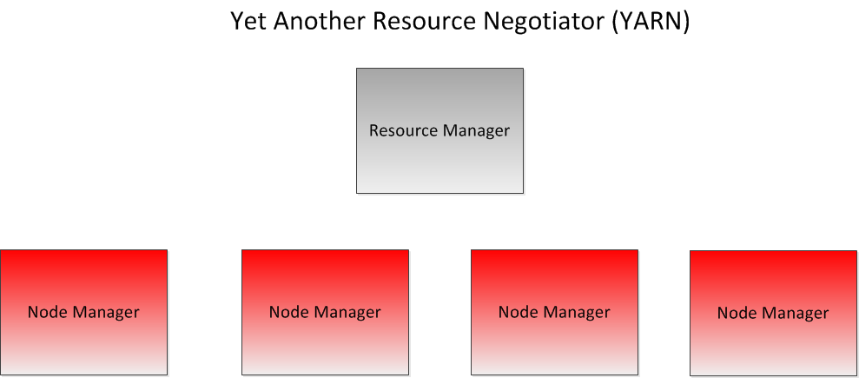
Notes:
1

Slide 80
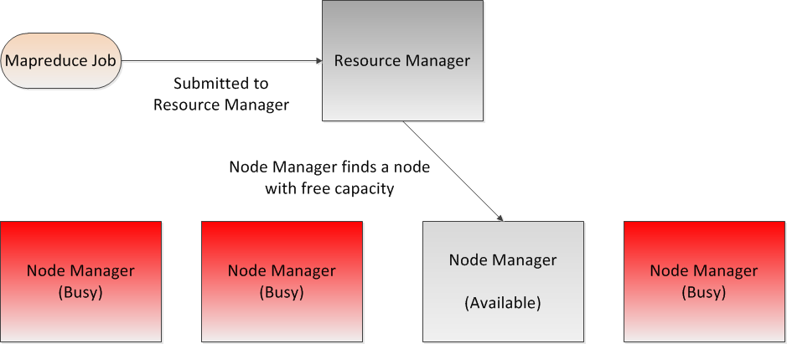
Notes:
1

Slide 81
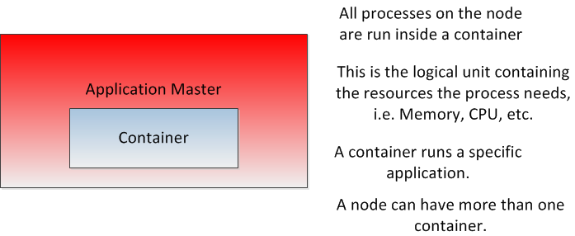
Notes:
1

Slide 82
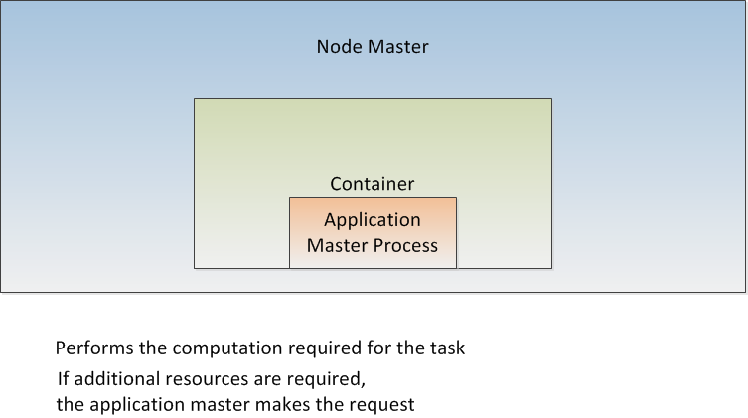
Notes:
1

Slide 83
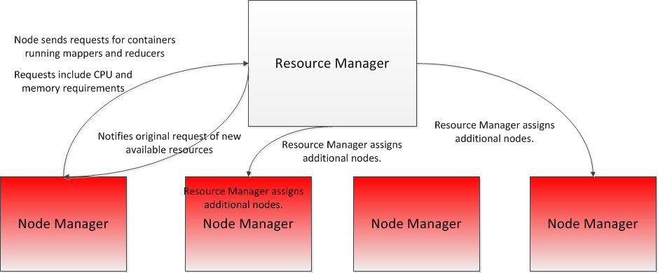
Notes:
1

Slide 84
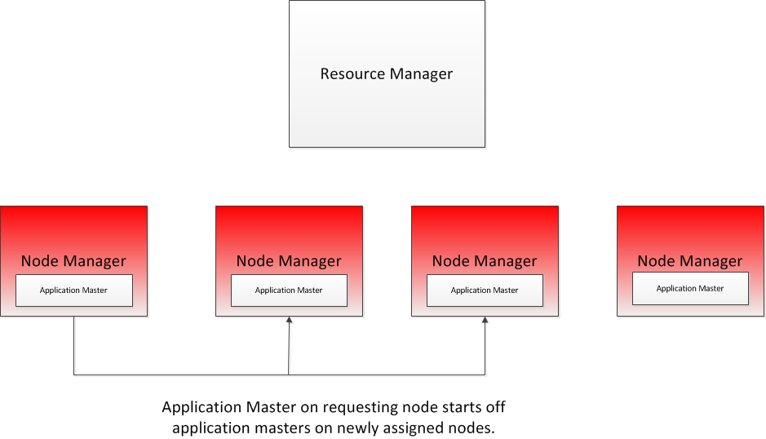
Notes:
1

Slide 85
YARN
All processes running in a node are run in a container.
A container is a logical structure.
A container is described by the resources it owns. For example, memory, CPU, storage, etc.
A container runs a specific application assigned to it.
A single node manager can support multiple containers.
Once the container has been created, the Resource manager starts the application process within that container.
Notes:
1

Slide 86
YARN
If the application requires more resources to complete its task, it makes a request for more containers via the Node manager to the Resource Manager.
Requests can include CPU or memory.
The Resource Manager scans the cluster looking for compute nodes with the available resources.
If it finds a suitable node, it requests the node manager to create a new container and assigns the extra work to it.
Finally, the original application master making the request is notified of the additional resources.
The application master than starts up new application masters on the newly available nodes.
Notes:
1

Slide 87
YARN
Most often, clusters have limited resources, so YARN will have to schedule work according to resource availability.
When scheduling work, several considerations must be taken into account.
First, write bandwidth must be limited.
It is better to assign the map computation close to where the data lives.
If the optimal node is busy, then we wait for the resources to become free.
We do this using scheduling.
Hadoop, by default, uses three types of scheduling algorithms.
Notes:
1

Slide 88
YARN
The first type of scheduling is the First In, First Out (FIFO) scheduler.
FIFO scheduling simply means that the first job submitted will take priority.
FIFO scheduling can be inefficient, if Job A is submitted first, and takes significantly more time to complete than Job B, that means that we cannot run Job B first.
FIFO scheduling can results in long wait times for jobs, therefore it is seldom used in practice.
Notes:
1

Slide 89
YARN
The next type of scheduling algorithm is the capacity scheduler.
The capacity scheduler implements multiple queues
Each queue is allocated a portion of the cluster's resources.
Jobs can be submitted to specific queues.
Within the queue itself, FIFO scheduling is used.
Note that queues cannot poach each other's allocated resources.
Capacity scheduling allows for parallelization of tasks.
The advantage of capacity scheduling is that small jobs don't get stuck behind larger ones.
The disadvantage is that you may have underutilization of some of the queues.
Notes:
1

Slide 90
YARN
The last type of scheduler is the fair scheduler.
In a fair scheduler, resources are always allocated proportionally to each job.
There is no wait time for any job.
The default policy for Hadoop is the capacity scheduler.
The default policy can be set in yarn-policy.xml
Notes:
1

Slide 91
Hadoop Monitoring
We need to be able to collect metrics.
Collecting Namenode metrics
Collecting DataNode metrics
Collecting HDFS metrics.
Notes:
1

Slide 92
Hadoop Monitoring
The Namenode has an HTTP RESTful API
Usually located at https://<namenode>:50070
You can also browse to http://<namenode>:50070/jmx
Notes:
1

Slide 93
Hadoop Monitoring
Each datanode also has an HTTP RESTful API
Usually can be found at:
http://<datanode>:50070/dfshealth.html
#tab-datanode
Also, can use the JMX API to collect data.
The ResourceManager exposes all the MapReduce counters for each job.
Default port for these metrics is at 8088 on the resource manager.
Notes:
1

Slide 94
Hadoop Monitoring
Many third party tools are available
Apache Ambari
Cloudera Manager
Both tools are free.
Notes:
1

Slide 95
Apache Pig
Apache Pig is a dataflow language for expressing data analysis and infrastructure processes
Pig uses both HDFS (to do file I/O) and MapReduce (to run jobs)
Pig is extensible through user defined functions that can be written in Java or other languages.
Notes:
1

Slide 96
Apache Pig
Pig has three components
The first is the Pig Latin language.
Pig Latin is a high level scripting language
Pig Latin doesn’t need any metadata or schemas
All PigLatin statements translated into a series of MapReduce jobs.
Notes:
1

Slide 97
Apache Pig
Pig has three components.
The second component is Grunt.
Grunt is the interactive shell for Pig.
Notes:
1

Slide 98
Apache Pig
The Pig Latin language is a language for expressing data analytics and infrastructure processes.
Supports many types of traditional data operations, such as join, sort, filter and others.
Simplifies joining data and chaining jobs together
Notes:
1

Slide 99
Apache Pig
Hcatalog can be used with Pig to offload location and metadata information requirements from Pig.
We no longer need Pig scripts to handle the data locations.
The dataflow model with Hcatalog looks like this:
Load (Hcatalog)
Transform (Pig)
Dump or Store (Pig)
Notes:
1

Slide 100
Apache Pig
Pig Latin Scripts describe a Directed Acyclic Graph Where the edges are dataflow and the nodes are data operations.
Notes:
1

Slide 101
Apache Pig
grunt> LOGS = load ‘sample.log’
grunt> LEVELS = FOREACH LOGS GENERATE (
REGEX_EXTRACT($0,’(INFO|DEBUG|WARN|ERROR|FATAL)’,1) AS LOGLEVELS
grunt> DUMP LOGLEVEL
Notes:
1

Slide 102
Apache Pig
The Pig interpreter evaluates each statement.
If the statement is valid, Pig adds it to the ‘Plan’ which is built by the interpreter..
The interpreter will not execute any statements until it finds a DUMP or STORE command.
Notes:
1

Slide 103
Apache Pig
Pig uses the concept of a ‘bag’ as its relational structure.
A bag is a collection of unordered tuples.
Each tuple corresponds to a row in a relational table.
Unlike a standard SQL relation, tuples don’t have to have the same data types or sizes
Notes:
1

Slide 104
Apache Pig
Pig has three data structures
The first is the bag
The second is the tuple
The third is the map (a collection of key/value pairs).
Notes:
1

Slide 105
Apache Pig
logevents = LOAD ‘input/mylog’ AS (date:chararray, level:chararray,code:int, message:chararray)
Severe = FILTER logevents BY (level = ‘severe’ and code >=500
Grouped = GROUP severe BY code
STORE grouped INTO ‘output/severeevents’
Notes:
1

Slide 106
Apache Pig
e1 = LOAD ‘pig/input/File1’ USING PigStorage(‘,’) AS (name:chararray,age:int,l
zip:int, salary:double)
f = FOREACH e1 GENERATE age,salary;
DESCRIBE f;
DUMP f;
Notes:
1

Slide 107
Apache Pig
Employees = LOAD ;pig/input/File1’ USING PigStorage(‘,’)
AS(name:chararray,age:int, zip:int, salary:double);
sorted = ORDER employees by Salary;
Employees = LOAD ‘pig/input/File1’ USING PigStorage(‘,’)
AS (name:charray, age:int, zip:int, salary:double);
Agegroup = GROUP employees by age;
li = LIMIT agegroup 100;
Notes:
1

Slide 108
Apache Pig
e1 = LOAD ‘pig/input/File1’ USING PigStorage(‘,’)
AS (name:chararray,age:int,zip:int,salary:double)
e2 = LOAD ‘pig/input/File2’ USING PigStorage(‘,’)
AS (name:chararray, phone:chararray);
e3 = JOIN e1 by name, e2 by name
DESCRIBE e3;
DUMP e3;
Notes:
1

Slide 109
Apache Pig
We can use illustrate, explain, and describe to help us debug pig latin scripts
Suggest using local mode to test the script before running it on the cluster
Local node is slow, but there is no waiting for a slot for the job to run
Logs for local mode appear on your screen instead of on the remote task node.
Local mode runs all in your local process so you can attach a debugger to it.
Notes:
<number>

Slide 110
Apache Hive
Hive is a data warehouse layer build on top of Hadoop
Allows you define a structure for your unstructured Big Data
Simplifies analysis and queries with an SQL like language called HiveSQL
Notes:
<number>

Slide 111
Apache Hive
Hive is not a relational database
Hive uses a database to store metadata but all data that Hive processes is stored in the HDFS.
Hive is not designed for OLTP
Hive runs on Hadoop (a batch processing system)
Hive latency is generally high
Hive is not suited for real-time queries and row-level updates.
Notes:
<number>

Slide 112
Apache Hive
Hive takes multi structured data and gives back a view and a structure which can make sense to a business analyst.
Hive supports uses such as
Ad-hoc queries
Summarization
Data analysis
Notes:
<number>

Slide 113
Apache Hive
The Hive architecture includes :
The Hive command line interface
The Metastore, which stores schema information and provides structure to stored data
The Hive QL, which supports query processing, compiling and optimizing
Notes:
<number>

Slide 114
Apache Hive
Hive is a good choice when you want to query the data
When you need an answer to a specific question
If you are already familiar with SQL
Pig is a good choice when you want to perform Extract , Transform and Load (ETL)
When you want to prepare data for easier analysis
When you have a long series of steps to do.
Notes:
<number>

Slide 115
Apache Hive
The HiveQL is similar to other SQLs
It uses standard relational database concepts such as tables, rows, columns and schema)
Supports multi-table insert via your code. It accesses ‘Big Data’ via tables
Converts SQL queries into MapReduce jobs
Also supports plugging custom MapReduce scripts into queries
Notes:
<number>

Slide 116
Apache Hive
A Hive table consists of:
Data: typically a file or group of files stored on the HDFS.
Schema: in the form of metadata stored in a relational database
Schema and data are separate
A schema can be defined for existing data
Data can be added or removed independently.
Hive can be pointed at existing data.
You must have a schema defined if you want to point Hive to existing data. In the HDFS.
Notes:
<number>

Slide 117
Apache Hive
Hive> CREATE TABLE mytable (name string, age int)
ROW FORMAT DELIMITED
FIELDS TERMINATED BY ‘;’
STORED AS TEXTFILE;
Notes:
<number>

Slide 118
Apache Hive
Hive> LOAD DATA LOCAL INPATH
‘/tmp/customers.csv’ OVERWRITE INTO TABLE customers;
Hive> LOAD DATA INPATH
‘user/train/customers.csv’ OVERWRITE INTO TABLE customers
INSERT INTO birthdays SELECT firstName, lastName, birthday FROM
customers where birthday IS NOT NULL;
Notes:
<number>

